Slide 1
Plant Summary
Campbell chapters 35-39
Derek Liu

Slide 2
Plant structure, growth, and development - Chapter 35

Slide 3
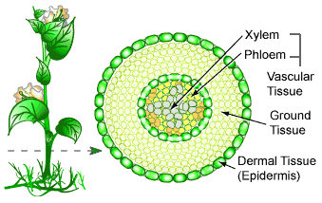
Plants have organs, tissues, and cells
Similar to animals
Vascular plants have 3 basic organs - roots, stems, and leaves
Also have 3 tissue systems - dermal, vascular, and ground
Dermal = skin
Vascular = veins
Ground = other functions

Slide 4
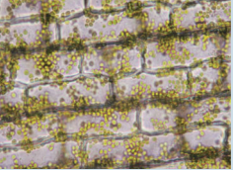
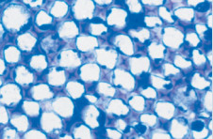
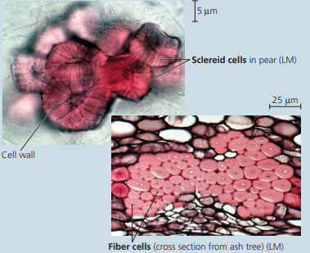
Important ground tissue cells
Parenchyma cells
Unspecialized
Thin-walled
Function for storage
Collenchyma cells
Support young cells of the plant
Sclerenchyma cells
Thick walled - made up of _____
Helps support mature parts of the plant
Sclereids and fibers
lignin

Slide 5
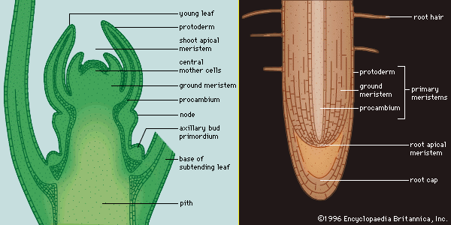
Meristems
Indeterminate growth
Meristems generate new cells
Two apical meristems (top and bottom)
Root apical meristem
Shoot apical meristem
Primary vs. secondary growth

Slide 6
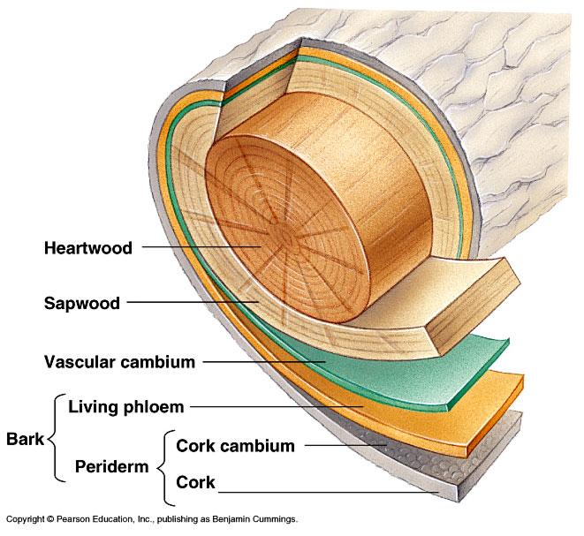
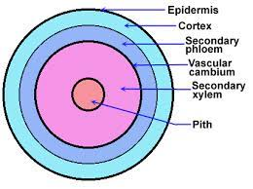
Secondary growth
Vascular cambium → secondary xylem and phloem
Cork cambium → periderm

Slide 7
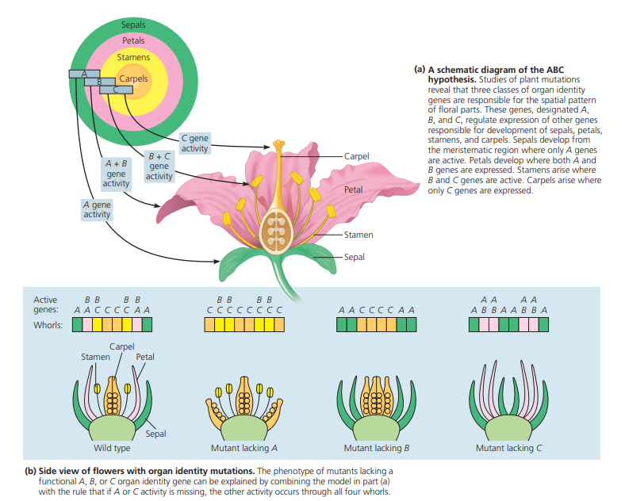
ABC Hypothesis

Slide 8
Resource Acquisition and Transport in Vascular Plants - Chapter 36

Slide 9
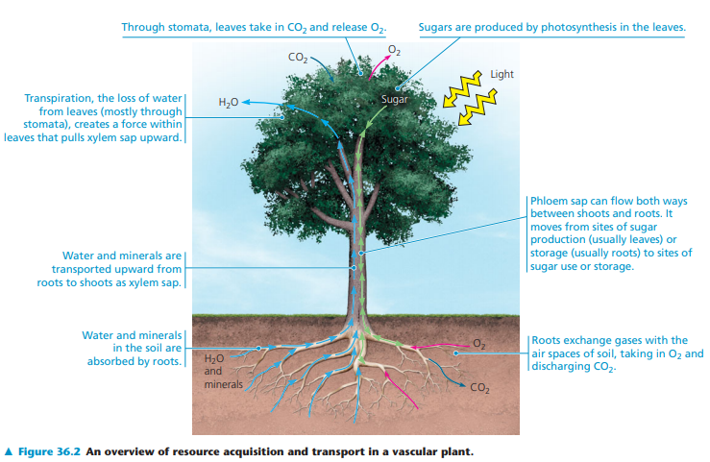

Slide 10
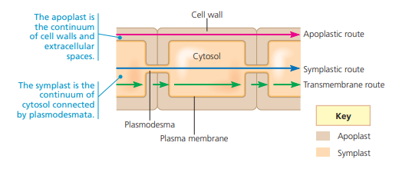
Short distance transport
Apoplastic route
Along cell walls
Symplastic route
Through plasmodesmata
Transmembrane route
Across the cell wall

Slide 11
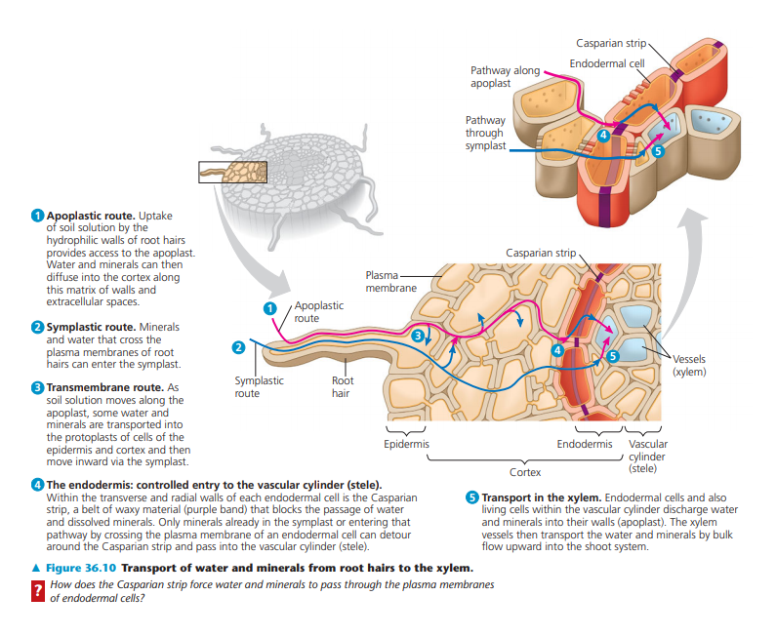
Casparian strip

Slide 12
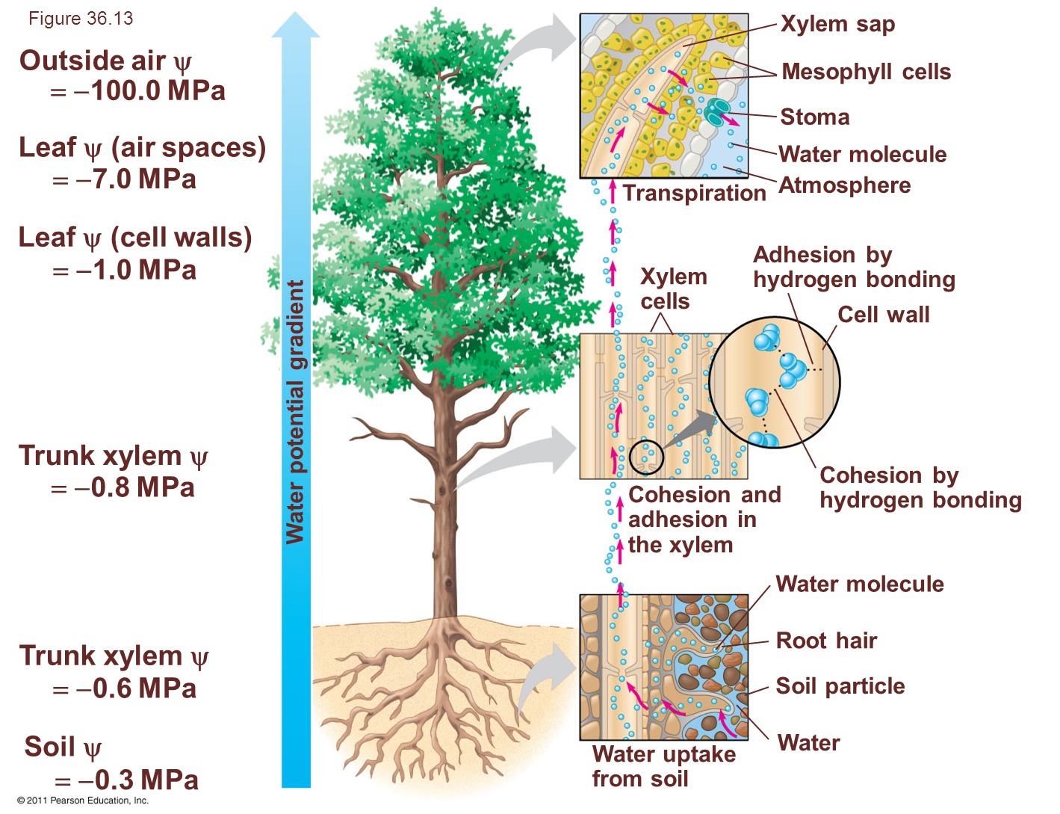
Transpiration
Loss of water vapor from plants
Stomata is a major pathway for water loss from plants
Guard cells widen/narrow stomatal pores
Regulated by ________________?
Abscisic acid

Slide 13
Soil and Plant Nutrition - Chapter 37

Slide 14
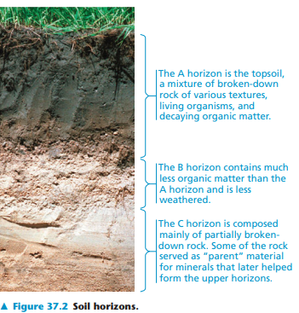
Soil
Soil contains a living, complex ecosystem
Humus → remains of dead organisms and other organic matter, forms topsoil
Soil layers → soil horizons

Slide 15
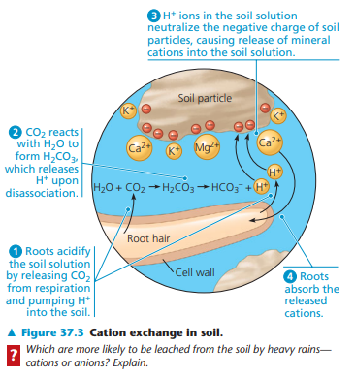
Cation exchange
Important process to gain ions from soil particles
H+ neutralizes charge of soil particles, making other ions release from the soil particle into the root hair

Slide 16
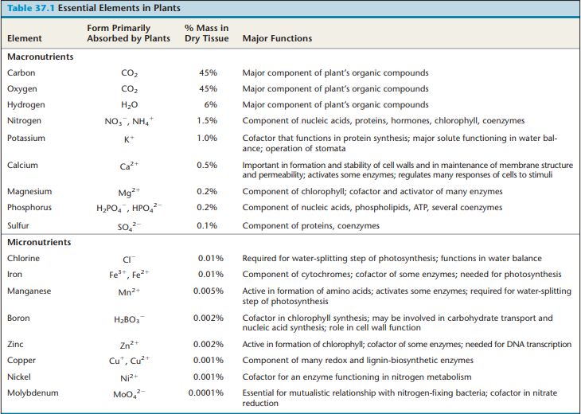
Huge table of important info that you could potentially cram in the day before the exam if you’re lazy like me

Slide 17
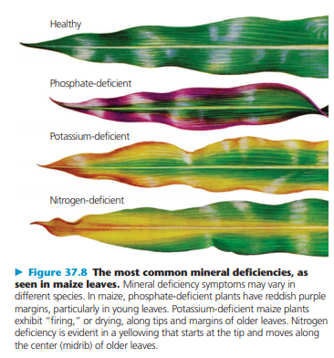
Mineral deficiencies
Phosphate → Purple
Potassium → Yellow around the edges
Nitrogen → Yellow in the center
Iron → Yellowing in young leaves rather than old leaves
Magnesium → Yellowing in old leaves rather than young leaves
What is the term for yellowing?
Chlorosis

Slide 18
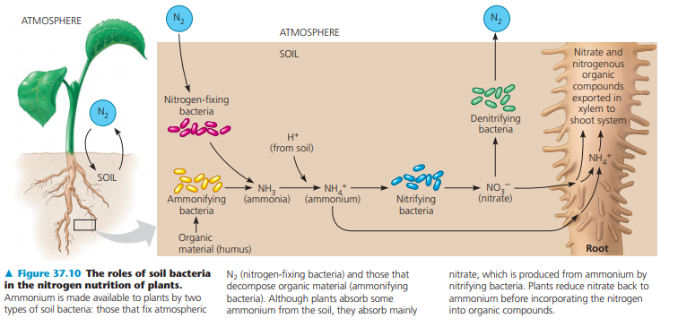
Roles of soil bacteria in nitrogen nutrition of plants
N2 → NH3 → NH4 → NO3 or NH4 into root
Important to know types of bacteria
Xylem carries nitrate and nitrogenous organic compounds into shoot system

Slide 19
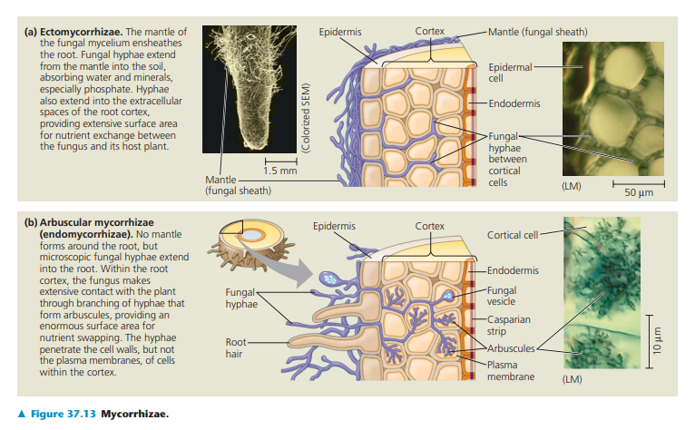
Mycorrhizae
Plant-fungus mutualism
Two types: ectomycorrhizae and arbuscular mycorrhizae (endomycorrhizae)
Ecto → fungal hyphae between cells (into extracellular spaces)
Endo → hyphae branches into cell walls, but not into membrane

Slide 20
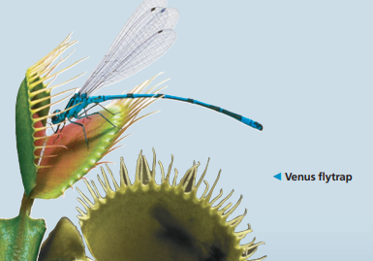
Epiphytes, parasitic plants, and carnivorous plants
Epiphyte → just chilling
Parasitic plants → parasite
Carnivorous plants → gain nutrition from eating animals (flies, ants, etc.)

Slide 21
Angiosperm Reproduction - Chapter 38

Slide 22
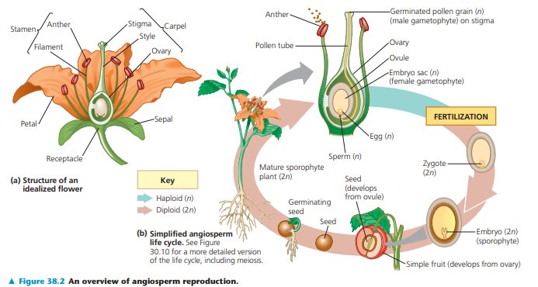
Overview of Angiosperm Reproduction

Slide 23
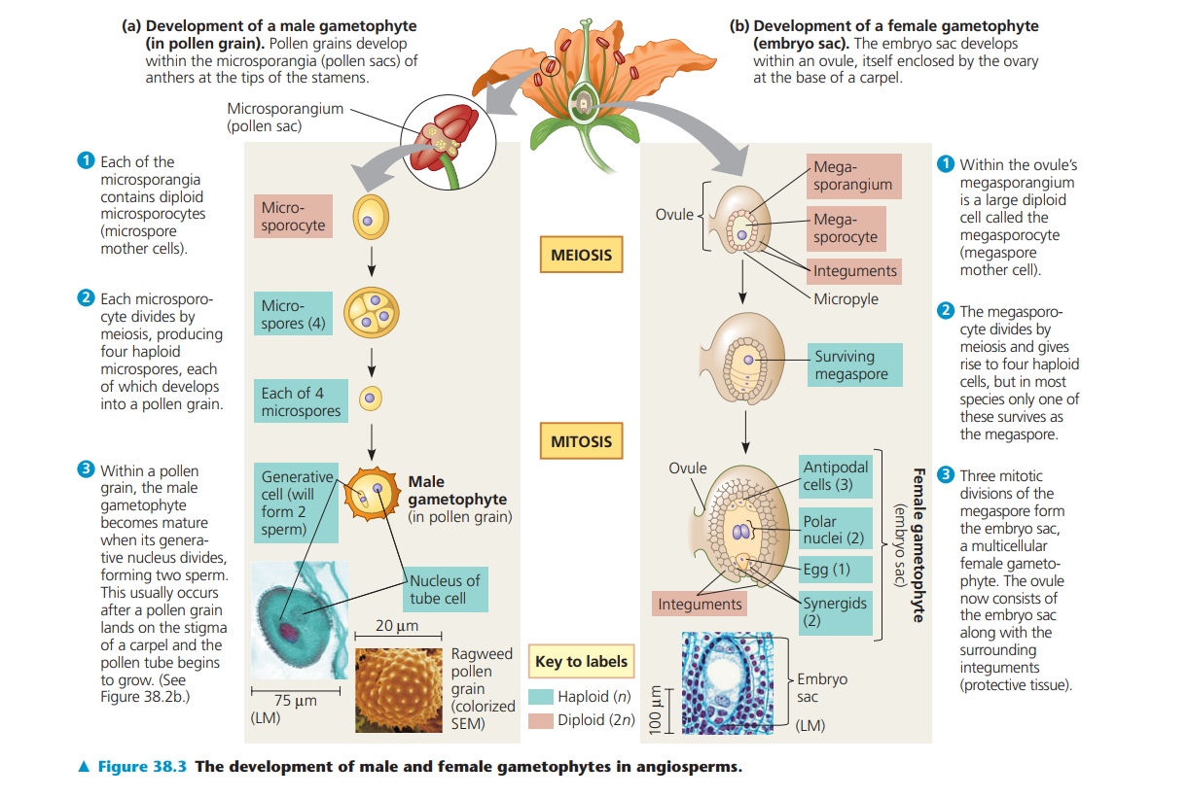
Development of male/female gametophyte
2 polar nuclei are in the female gametophyte
Eventually becomes endosperm
Generative cell nuclei will form 2 sperm once the pollen tube begins to grow

Slide 24
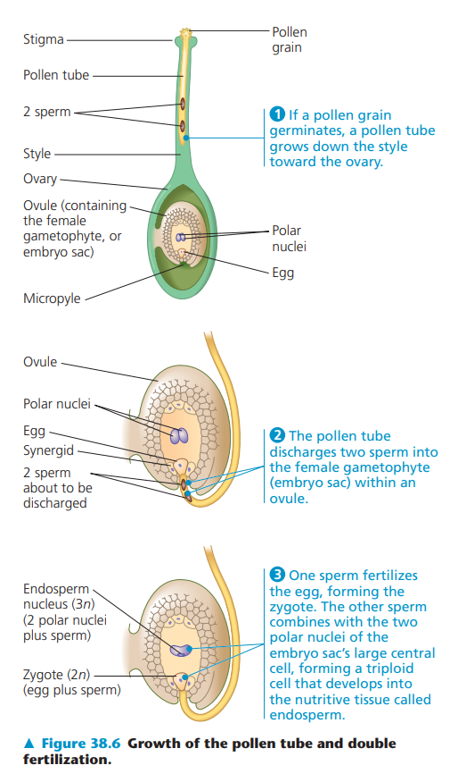
Double Fertilization
Pollen tube discharges two sperm
One sperm fertilizes egg
Other sperm combines with polar nuclei to form the endosperm
Endosperm acts as food for the plant embryo

Slide 25
Types of pollination
Wind - small, green
Bees - ultraviolet, nectar guides
Moths/Butterflies - white/yellow, sweet fragrant
Flies - rotten meat
Bats - light colored and fragrant
Birds - bent floral tube, nectar, large and bright red/yellow

Slide 26
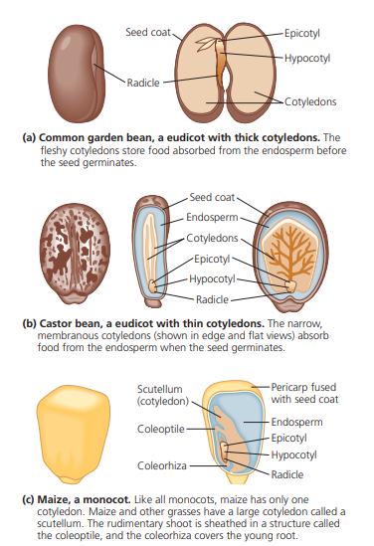
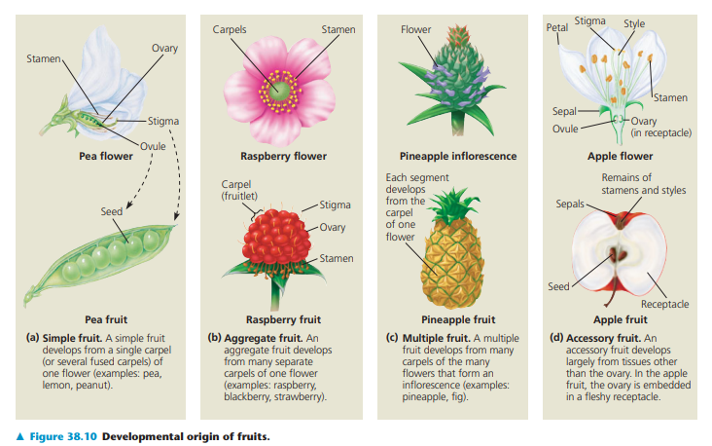
Cotyledons and fruits

Slide 27
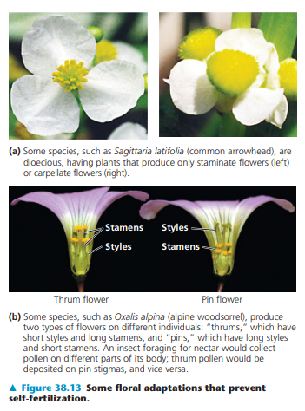
Self-fertilization
Generally not a good thing
Plants have adapted and developed mechanisms to prevent self-fertilization
Dioecious species
Thrums & pins

Slide 28
Plant Responses to Internal and External Signals - Chapter 39

Slide 29
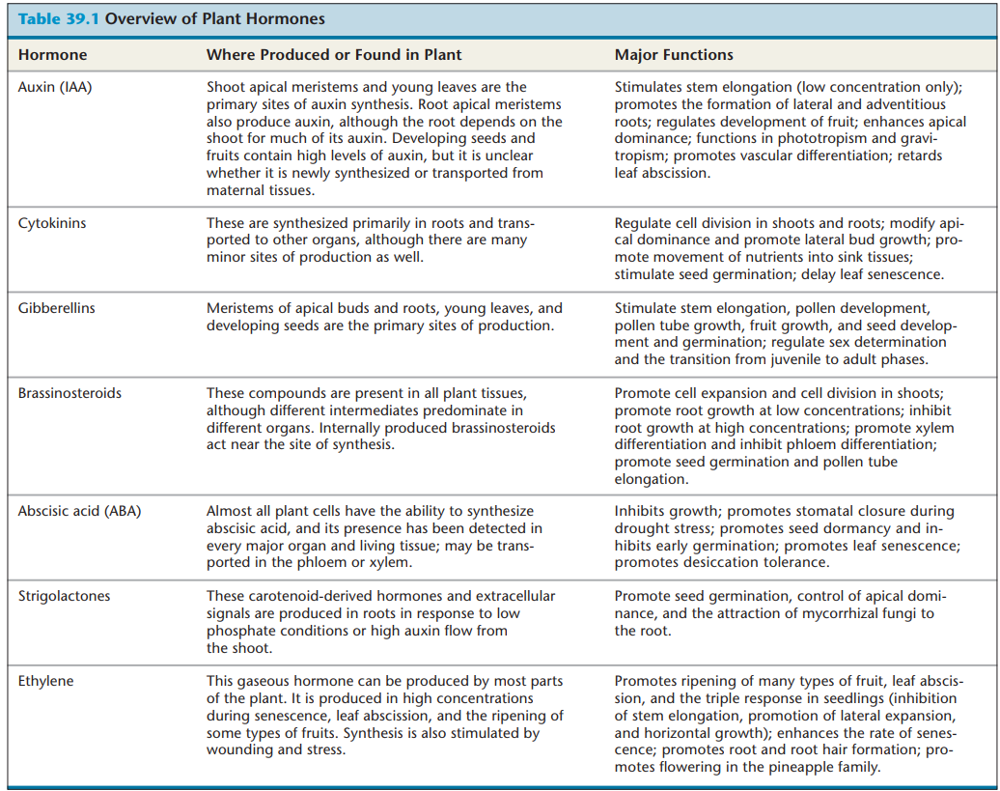
Another very important table that you probably shouldn’t cram the day before the exam

Slide 30
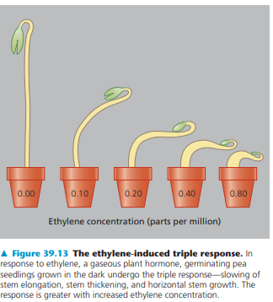
Triple Response
In response to ethylene:
Plant slows stem elongation
Plant stem thickens
Stem grows horizontally

Slide 31
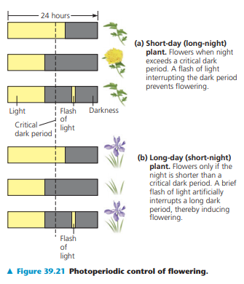
Photoperiodism
Short-day (long-night) flowers
Flowers if they sense a long night
Long-day (short night) flowers
Flowers if they sense a short night
Important to know how flashes of light during its critical period affect its blooming

Slide 32
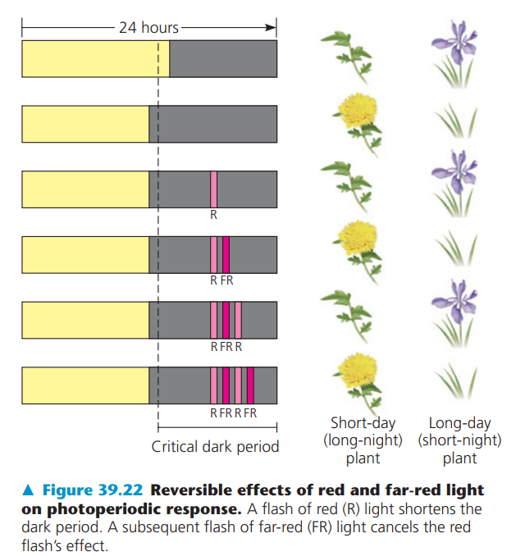
R/FR Flashes
Red light shortens the dark period
Far-red light cancels the red light

Slide 33
Plants also respond to other stimuli
Gravitropism
Bending of an organ in response to gravity
Plants detect gravity by using statoliths (starch-filled plastids)
Thigmotropism
Growth response to touch
Plants also have action potentials

Slide 34
Plants are sensitive to environmental stresses
Drought
Closing stomata
Flooding
Air tubes
High salinity
Producing solutes
Halophytes can survive long
Extreme temperature
Heat-shock proteins

Slide 35
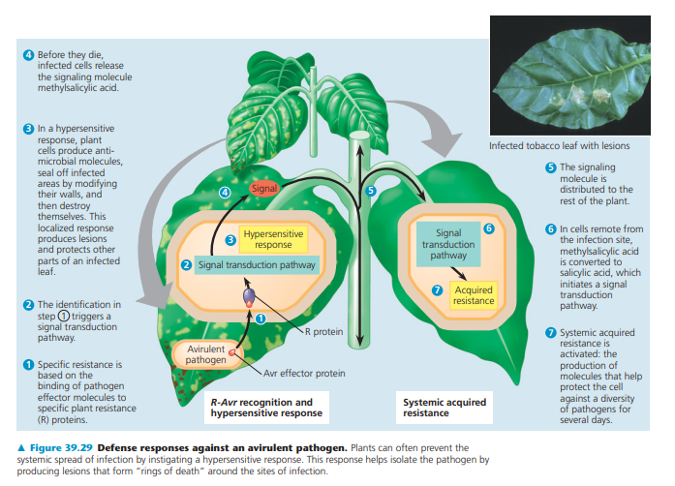
Response to invasion by pathogen

